Slide 1

Security For Internet Of Things(Industrial IOT)
Group 10
Prabhat Bhatt
Ritika Ray
Snehith Sharath

Slide 2
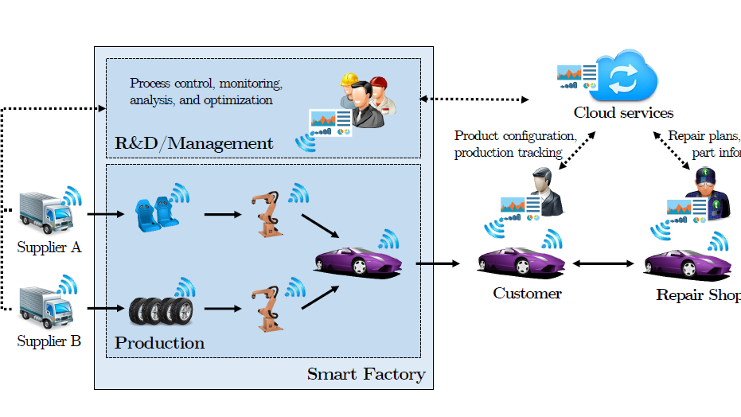
IIoT Concept

Slide 3

Risk
Risk of making all that detailed company information accessible through the Internet and leaving internal systems vulnerable to hacking, viruses and destructive malware

Slide 4
Services
Authentication
Confidentiality
Data Integrity
Preventing man-in-middle attack and/or modification of messages

Slide 5
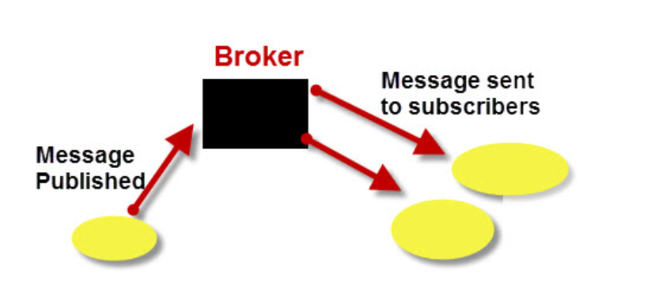
Authentication
MQTT

Slide 6
MQTT
Why MQTT??
It provides an always on connection. Thus, anytime a server updates a file in a certain topic the subscribed station automatically subscribes to the updated file.
There is no direct connection between the main server and the individual stations
If the main server were to go offline for some reason the broker would be able to provide the files to the subscribers if they are subscribed to the topic
MQTT offers three Quality of Service(QOS) at most once, at least once and exactly once

Slide 7
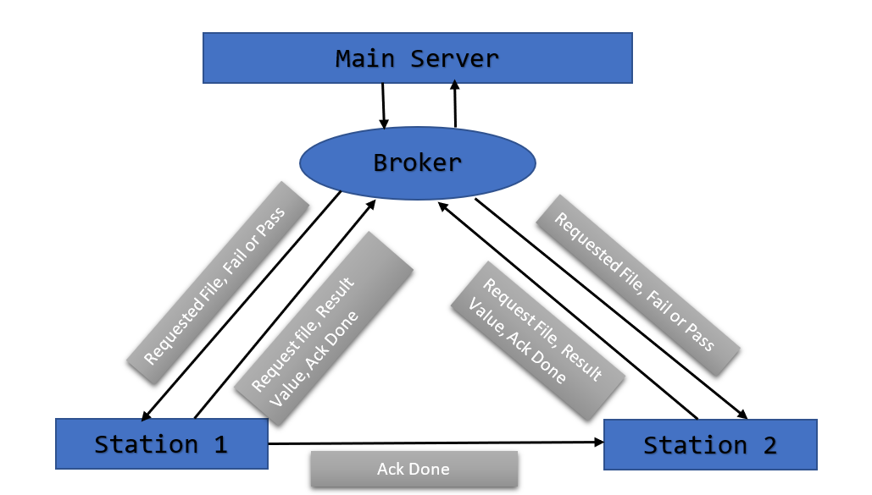
MQTT

Slide 8
Confidentiality and Integrity
AES and RSA encryption
256bit AES Encryption
32-byte AES key
16-byte RSA key

Slide 9
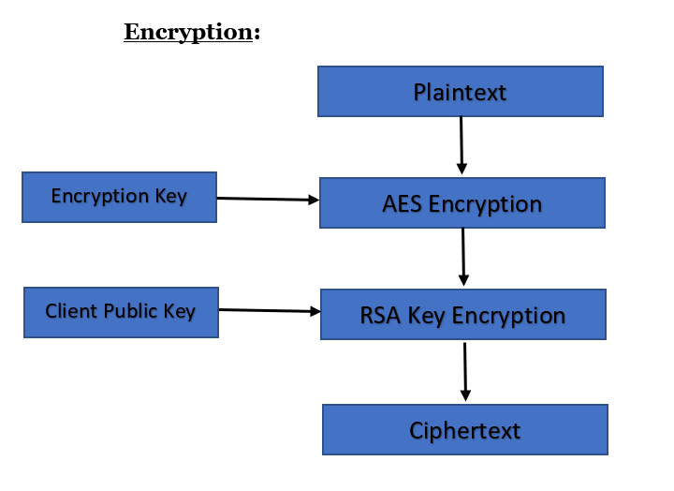
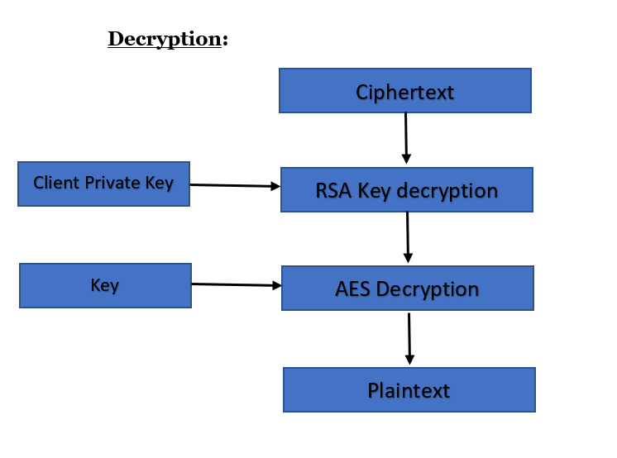
AES and RSA

Slide 10
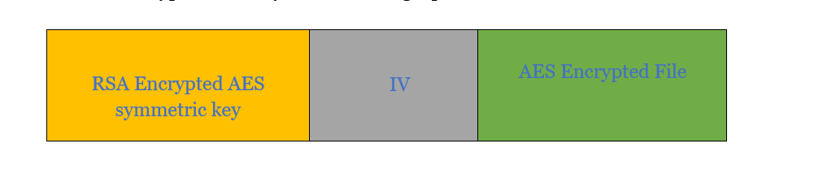
AES and RSA

Slide 11
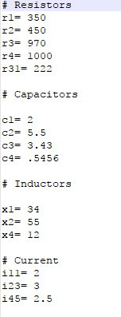
Encryption and Decryption
Encrypted file
Decrypted file

Slide 12
Attack
We are going to simulate an attack where an attacker tries to subscribe to all topics in the broker
Even if the attacker is able to get the file the attacker will not be able to decrypt the file as the attacker will not have the Key
Also the authentic stations will not be denied access to the files as all subscribers to the files are able to get the file
We will now show this in the demo

Slide 13

List of sources
http://internetofthingsagenda.techtarget.com/opinion/Manufacturing-embraces-the-Industrial-Internet-of-Things
Lancen Lachance, “IOT security in the Auto Industry”, https://www.globalsign.com/en/blog/iot-automobile-industry-sae-congress/
TechTarget, “Prevent Enterprise IoT Security Challenges”, “IOT Agenda”, 2017
“Building Smarter Manufacturing With The Internet of Things” http://cdn.iotwf.com/resources/6/iot_in_manufacturing_january.pdf
Liu Tenghong, Yuan Rong, Chang Huating ,“Research on the Internet of Things in the Automotive Industry” , 2012 International Conference on Management of e-Commerce and e-Government
Ahmad-Reza Sadeghi, Christian Wachsmann, Michael Waidner, “Security and Privacy Challenges in Industrial Internet of Things”, DAC ’15, June 07 - 11, 2015, San Francisco, CA, USA
Deutsche Telekom AG, “Security on the industrial internet of things”
Ericsson White paper, “IoT Security”, February 2017

